Slide 1
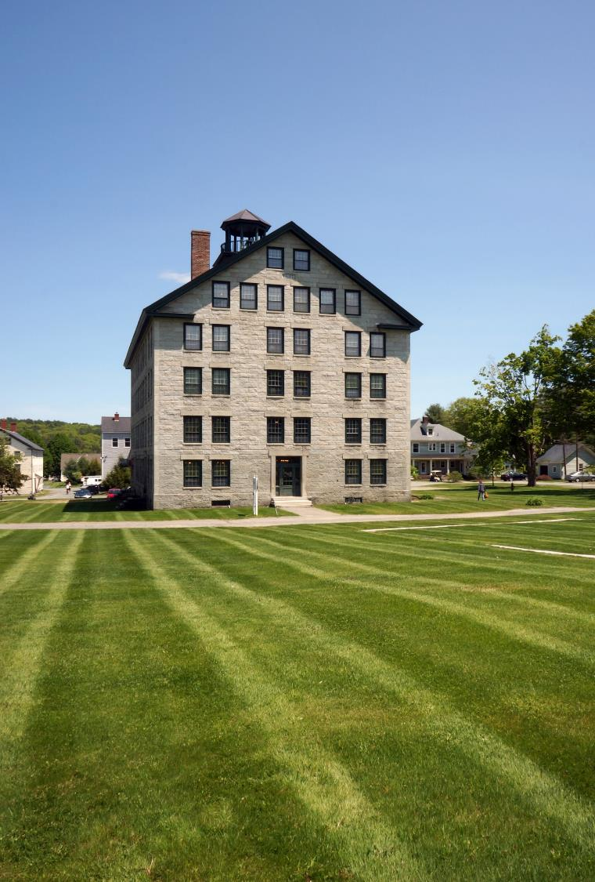
A Visit to the
Enfield Shaker Museum

Slide 2
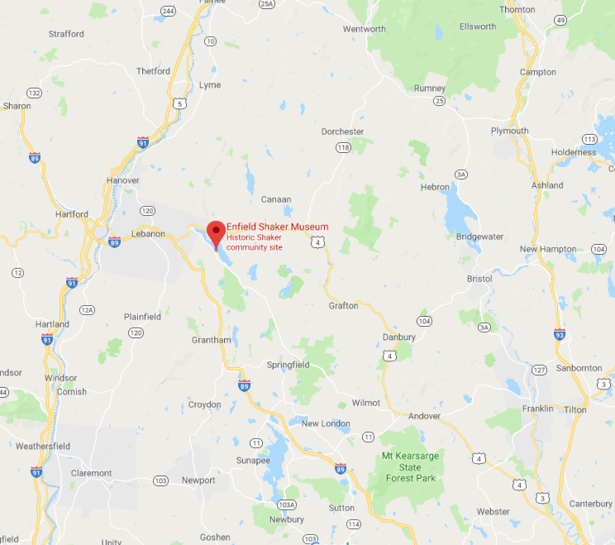
Where is the Museum located?
Notes:
The address of the Museum is 447 NH Rt 4A Enfield, NH 03748. The Museum is located on the west side of Mascoma Lake. Tucked in between the lake’s shore and Mount Assurance.

Slide 3
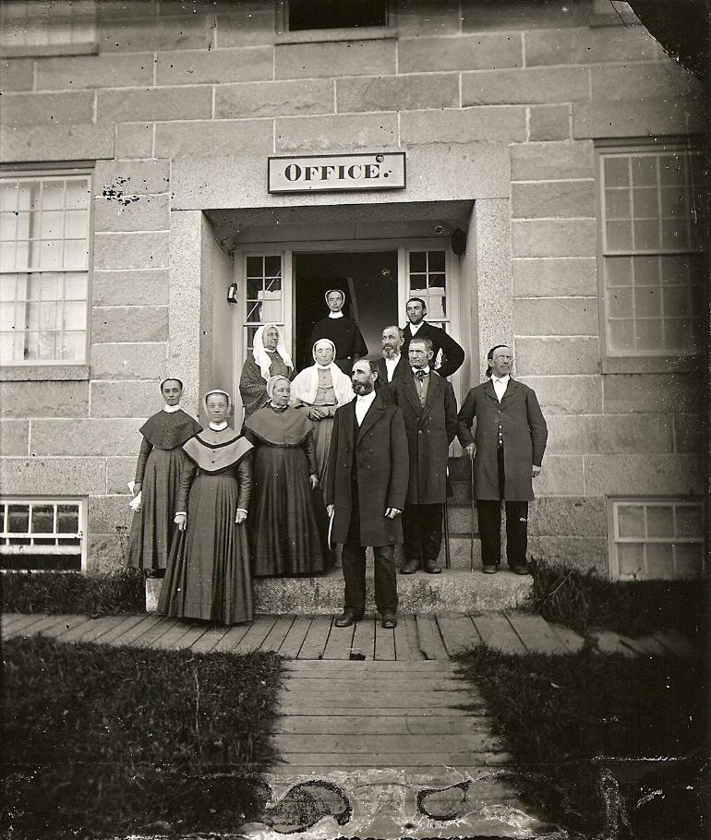
Who are the Shakers?
Notes:
The United Society of Believers in Christ’s Second Appearing better known as the Shakers were an American communal religious group originally founded in 1747 in Manchester, England. At the height of the order there were around 18 substantial Shaker communities which housed around 5000 people. These villages were established as far north as Maine and as far south as Kentucky. In New Hampshire there were two Shaker villages, one at Enfield and one at Canterbury.

Slide 4
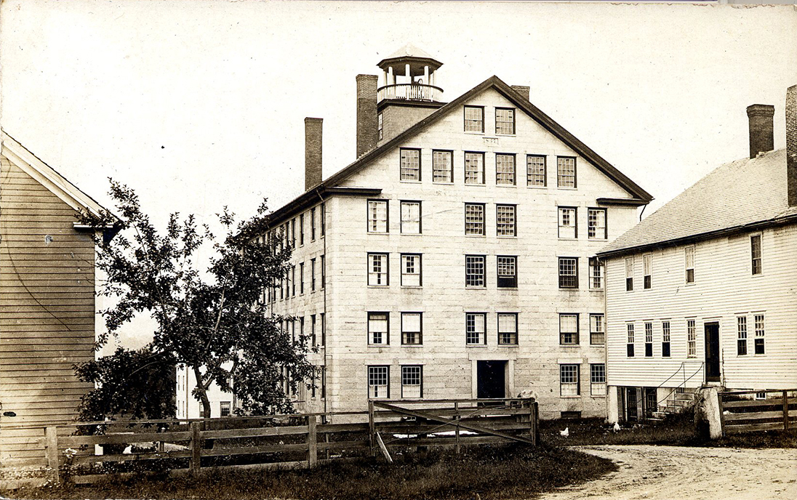
The Enfield, NH Shaker Village
1793 - 1923
Notes:
Founded in 1793, this village was the 9th of 18 major Shaker communities to be established in this country. At its peak in the mid 19th century, the community was home to three “Families” of Shakers. Here, Brothers, Sisters, and children lived, worked, and worshipped. Here, they practiced equality of the sexes and races, celibacy, pacifism, and communal ownership of property. Striving to create a heaven on earth, the Enfield Shakers built more than 200 buildings (including the Great Stone Dwelling, the largest Shaker dwelling ever built), farmed over 3,000 acres of fertile land, educated children in model schools, and followed the “Shaker Way” of worship.

Slide 5
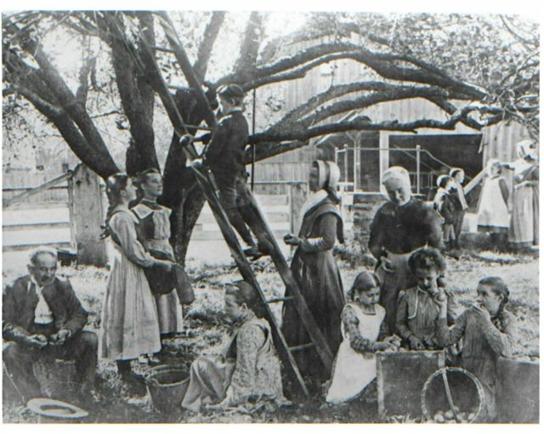
Daily Life in a Shaker Village
Notes:
Daily life in a Shaker Village had a routine. Shakers typically woke up at 4:30 am in the summer and 5:30 am in the winter. They then worked on morning chores until they had breakfast at about 7:30 am. The Shakers would then go to work for a couple of hours before gathering for the Noon Meal. The Shakers would then return to work till they had supper around 6:00 pm. After supper the Shakers would gather for union meetings or worship services depending on the night of the week.

Slide 6
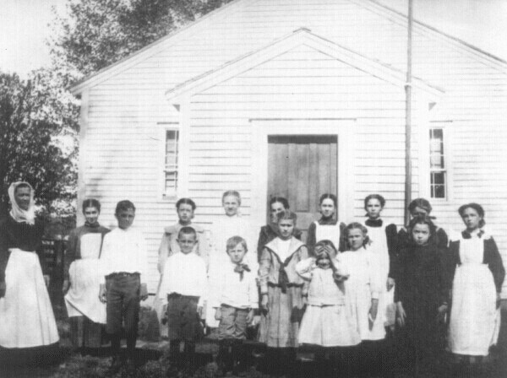
Growing up Shaker
Notes:
All Shaker Villages had children who lived in the community. While many of them came with a parent others were local orphans. Shaker children received both an academic and trade education. Boys attended school in the winter while girls went in the summer. The school schedule was based around the agricultural year. Boys and Girls lived in separate houses in the village where they were taken care of by adult Shakers. At around age 16, Shaker youth would begin to live in the adult dwelling house. Typically between ages 18 and 21 they could decide whether they wanted to stay in the community or leave.

Slide 7
Our Site

Slide 8
Great Stone Dwelling
Notes:
The Great Stone Dwelling served as the center of life and worship for the Church Family Shakers. They started building it in 1837 and finished it in 1841. At the height of the community over 100 Shakers called this building their home.

Slide 9
1854 Cow Barn
Notes:
The Cow Barn housed the Shakers’ herd of 26 Durham cows. This four-floor structure was a high drive barn which allowed hay carts to enter the ramp on one side of the barn and exit the ramp on the other.

Slide 10
Brethren’s East Shop
Notes:
The Brethren’s East Shop was built in 1819 and was used as a tailoring workshop by the Shaker Brothers. It was also the first schoolhouse for the Church Family.

Slide 11
Brethren’s West Shop
Notes:
The Brethren’s West Shop was built in 1820 and served as the center of small crafts including broom making.

Slide 12
Stone Machine Shop
Notes:
The 1849 Stone Machine Shop contained three floors of water powered machinery and was an industrial center for the Shaker Village.

Slide 13
Laundry and Dairy
Notes:
The Laundry and Dairy were built in 1813 and are the oldest remaining buildings on the Shaker site. The Laundry also called the Wash House was where the massive amount of dirty clothes were washed by the Shaker Sisters. The Dairy was used to produce both butter and cheese.

Slide 14
Mary Keane Chapel
Notes:
The Chapel was built in 1929 after the Shakers sold the site in 1927. The building was used for daily workshop while the site was inhabited by the Catholic La Salette Order.

Slide 15
Ministry House
Notes:
The Ministry House was built in 1880. It was used as housing and workspace for the Ministry. The Ministry were the leaders who oversaw both the Enfield and Canterbury Shaker Villages.

Slide 17
Notes:
In this photograph we see on the Sisters’ retiring rooms on the 5th floor of the Great Stone Dwelling. The Shakers used large built-in drawers such as these to store the large amounts of good needed by the 100 people whole lived in this building. In the middle of the picture is a spinning wheel which was manufactured by the Enfield Shakers in a short-lived business.

Slide 18
Notes:
This photograph shows the broom shop in the Brethren’s West Shop. Today, the Museum still makes brooms the old-fashioned way with period broom winders. For a beginner it takes about 3 hours to manufacture a broom. At the height of the community, the Enfield Brothers produced 24,000 a year which works out to roughly 65 a day!

Slide 19
Notes:
One of the twenty-four retiring rooms in the Great Stone Dwelling this photograph show several Shaker pieces including tables and chairs. Chairs are one of the most identifiable items in Shaker communities. To figure out where a Shaker chair came from all you must do is look at the design of the finial (pointed out by the white arrow). On Enfield, NH chairs, the finial looks like the shape of a candleflame.

Slide 20
Notes:
In this photo, we can see three different sewing desks made by the Enfield Shakers from the 1820s (one on the left) through the 1850s (one in the middle and on the far right). These pieces were often made by the Brothers for Sisters who were responsible for making sewing or knitting items for sale. They were designed to have lots of storage which is why you see all the drawers. The desk in the middle also has a table top that can be pulled out to increase your work space.

Slide 21
What do you think these artifacts are?

Slide 22
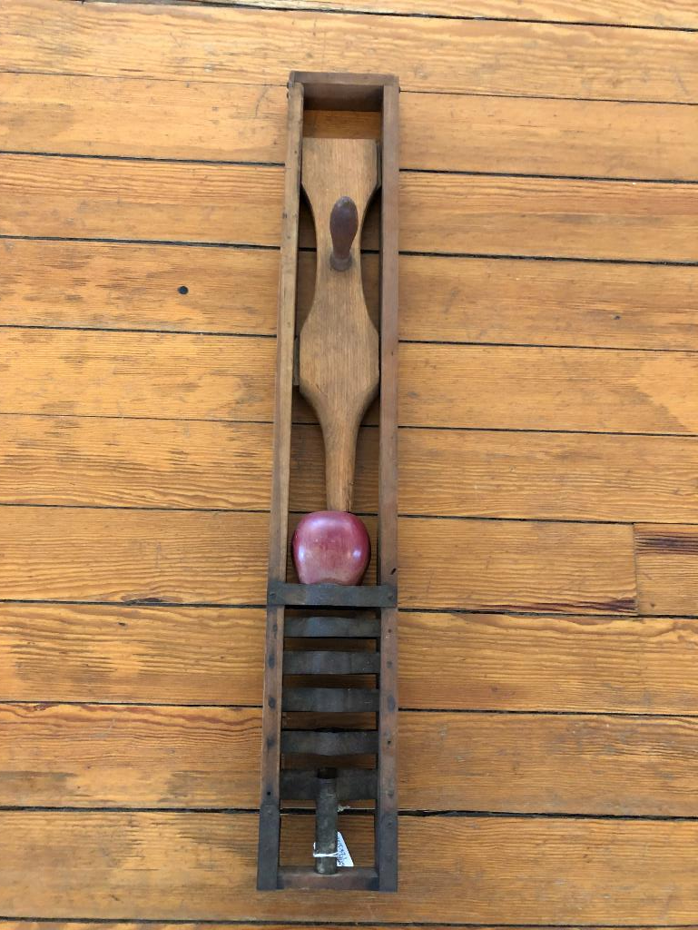
Object #1
Notes:
Object #1 is a Shaker apple slicer and corer. A Shaker sister would stand it up and then push the apple through the metal blades with a mallet. It produces nice apple slices that can be used in baked dishes such as Apple Pie. The Shakers ate apple pie for breakfast.

Slide 23
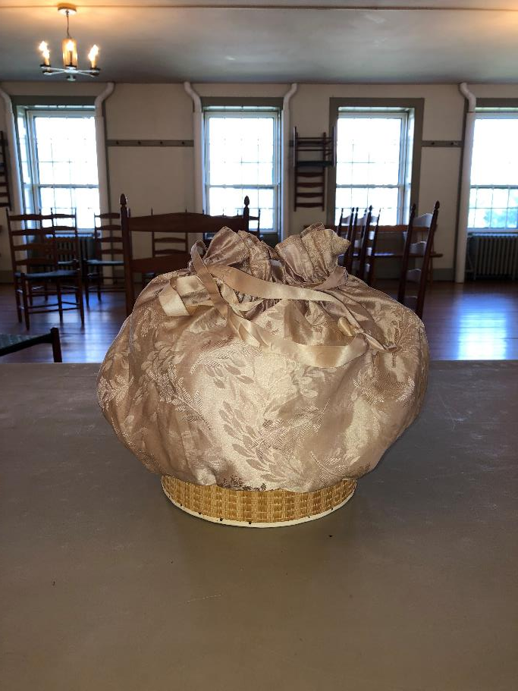
Object #2
Notes:
Object #2 we nicknamed the Jiffy Pop. This is an example of Shaker poplarware. Poplarware is a craft that is made from thin strips of wood. The Shakers started to sell poplarware boxes after the Civil War and the trade continued until the mid-twentieth century. Both Enfield and Canterbury Shaker Villages were involved in this business.

Slide 24
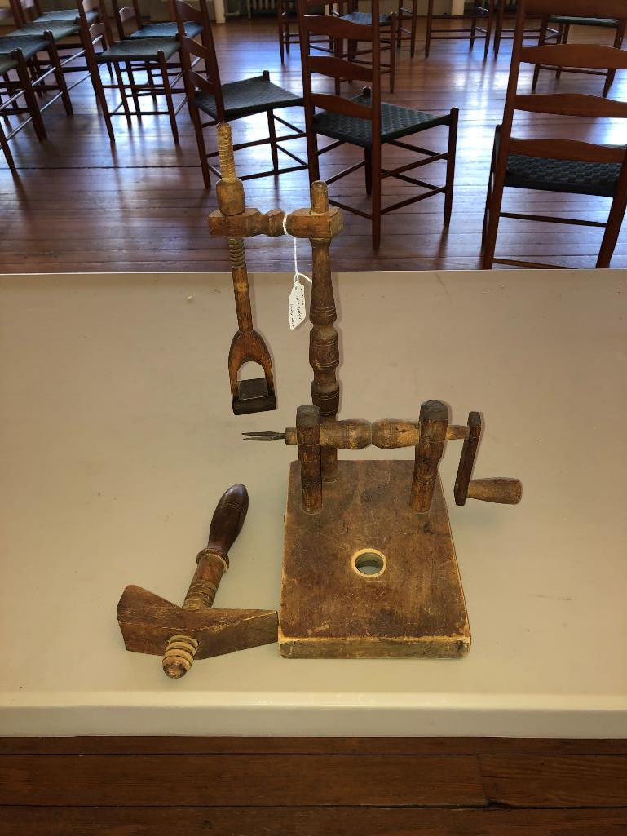
Object #3
Notes:
Object #3 is an apple peeler. The apple would be pushed onto the fork piece where it could be turned against the blade which hangs down from the stand.

Slide 25
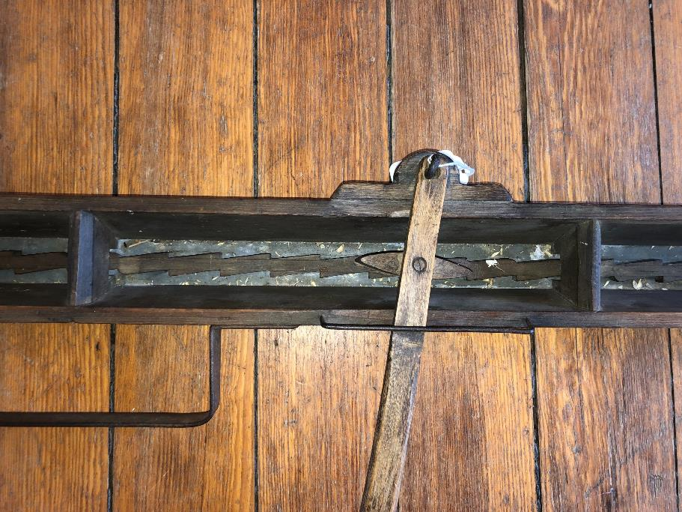
Object #4
Notes:
Object #4 is a seed planter. This long device would have a leather strap that the user would hang on the user’s shoulders. They would then move the handle back and forth which would allow the seeds to drop through tiny holes in the bottom of the planter.

Slide 27
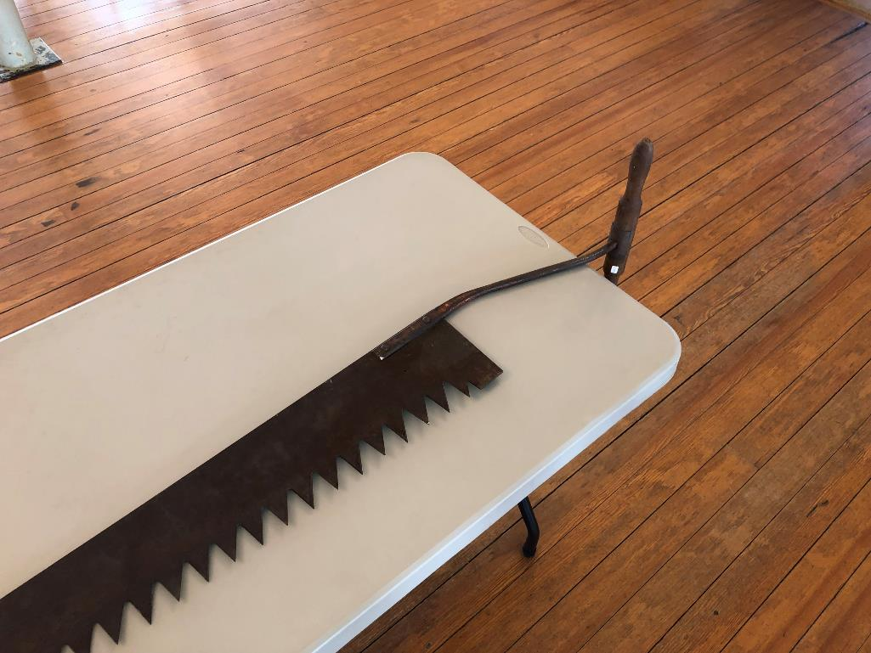
Object #5
Notes:
Object #5 is an ice saw. Sawing blocks of ice from frozen ponds and lakes was an important activity for the Shakers and other Americnans. In an age before refrigerators, block ice provided a way to preserve food for longer periods of time.

Slide 28
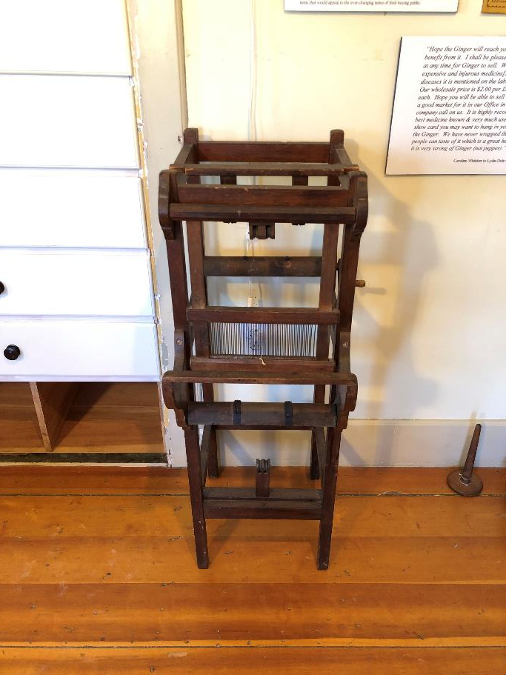
Object #6
Notes:
Object #6 is a Shaker tape loom. Many Shaker chairs use woven or list seats. In order to weave narrow chair “tape” you need a much smaller loom than you would use for other textile items.

